Slide 1

OCCUPATIONAL HEALTH & SAFETY
Occupational Health and Safety
FALL SEMESTER, 2023

Slide 2
JÜLİDE ZEYNEP AYDIN
Occupational Health and Safety
METU MINING ENGINEER, B.Sc, 2000
UNIVERSITY OF ILLINOIS-CHICAGO, MBA, 2003
SERIAL ENTREPRENEUR
SOCIAL ENTREPRENEUR
INSTRUCTOR

Slide 3
Occupational Health and Safety
LECTURE INFORMATION
LECTURE HOURS : MONDAY 17:30 – 18:15
WORKING HOURS : TUESDAY 17:30 – 18:15
ONLINE LECTURE PLATFORM WILL BE ANNOUNCED
IN CLASS EXAMINATIONS
MOBILE : 0532 345 8641
E-MAIL : julidezeynep@gmail.com
SUBJECTS
OHS TERMINOLOGY & HISTORY
WORKPLACE HAZARDS
RISK ASSESSMENT
ACCIDENT INVESTIGATION
INDUSTRIAL HYGIENE
OHS LAWS, CODES & REGULATIONS
FUTURE OF OHS
ETHICAL ISSUES IN OHS

Slide 4
Occupational Health and Safety
EXAMS & ASSIGNMENTS | WEIGHT
MIDTERM | 40 %
FINAL | 60 %
ASSIGNMENT | Shall be evaluated with the Final exam

Slide 5
HOLISTIC TERMINOLOGY
Occupational Health and Safety
OCCUPATION
type of work that includes tasks, education and training, typical wages, work settings, and other factors
HEALTH
state of complete physical, mental and social well-being and not merely the absence of disease or infirmity
SAFETY
state in which hazards and conditions leading to physical, psychological or material harm are controlled in order to preserve the health and well-being of individuals and the community
OCCUPATIONAL
HEALTH
&
SAFETY

Slide 6
BASIC CYCLE OF A WORKPLACE ACCIDENT
Occupational Health and Safety
SOURCE
PATH
RECEPTOR
&
IMPACT

Slide 7
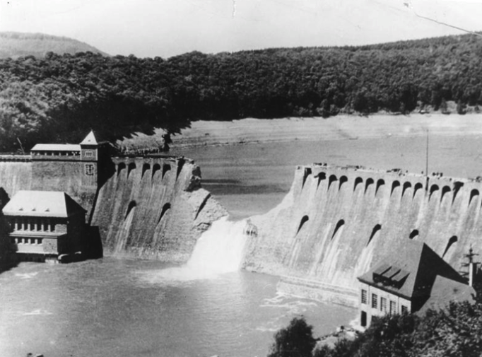
HISTORICAL DISASTERS AND IMPACTS
Occupational Health and Safety
ENERGY INDUSTRY
VISIBLE CYCLE OF THE ACCIDENT
HEAVY RAIN
WATER
DAM COLLAPSED & 250000 PEOPLE KILLED
1975 BANQIAO DAM FAILURE

Slide 8
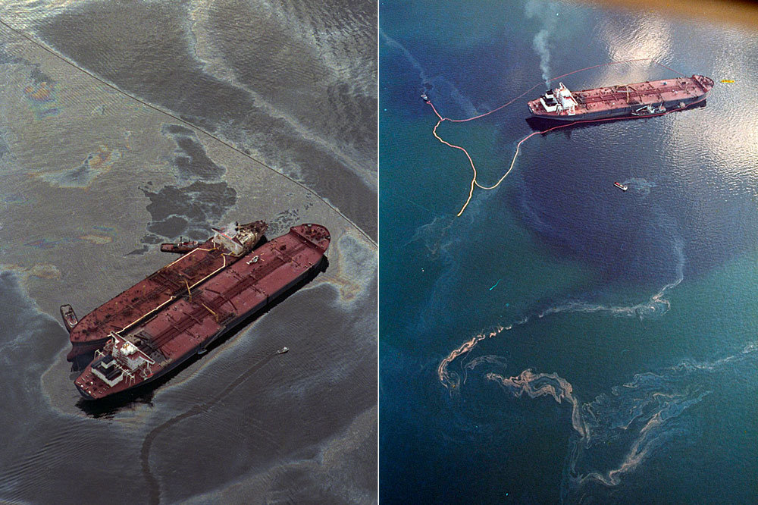
HISTORICAL DISASTERS AND IMPACTS
Occupational Health and Safety
ENERGY INDUSTRY
VISIBLE CYCLE OF THE ACCIDENT
OIL
WATER
OIL SPILL & HUGE LIVING SEA HABITAT DESTROYED
1989 EXXON VALDEZ OIL SPILL

Slide 9

HISTORICAL DISASTERS AND IMPACTS
Occupational Health and Safety
FOOD INDUSTRY
VISIBLE CYCLE OF THE ACCIDENT
UNKNOWN
FIRE
IMMINENT FIRE &
13 PEOPLE KILLED
1875 DUBLIN WHISKEY FIRE

Slide 10
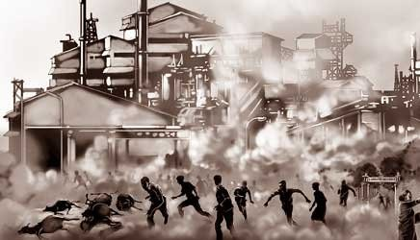
HISTORICAL DISASTERS AND IMPACTS
Occupational Health and Safety
MANUFACTURING INDUSTRY
VISIBLE CYCLE OF THE ACCIDENT
METHYL ISOCYANATE
AIR
UNMEASURABLE HUGE IMPACT
1984 BHOPAL UNION CARBIDE INDIA LTD. GAS LEAK

Slide 11

HISTORICAL DISASTERS
Occupational Health and Safety
BIOMEDICAL INDUSTRY
VISIBLE CYCLE OF THE ACCIDENT
SYRINGE TIDE
AIR, WATER, SOIL
WASH UP & ENVIRONMENTAL DESTROY
1988 SYRINGE TIDE CONNECTICUT BIOMEDICAL WASTE DISPOSAL

Slide 12
BASIC COMPONENTS
Occupational Health and Safety
TYPES OF HAZARDS
PATH & RECEPTORS
HAZARDS
BIOLOGICAL
CHEMICAL
PHYSICAL
MECHANICAL
PHYCHOSOCIAL
SAFETY
ERGONOMICS
ENVIRONMENTAL
PATH | RECEPTORS
AIR | HUMAN
WATER | ANIMALS
SOIL | PLANTS & TREES
FIRE | OTHER LIVING HABITAT
 | ENVIRONMENT
 | NEXT GENERATIONS

Slide 13
THE REAL LIFE CYCLE
Occupational Health and Safety
ROOT CAUSE
VISIBLE SOURCE & HAZARD
VISIBLE PATH & RISKS
PRIMARY RECEPTORS & THE OTHERS
THE ACCIDENT & IMPACTS
20:28

Slide 14
SAFETY IS NOT ACCIDENTAL. IT IS MAINTAINED CONSCIOUSLY. GOOD ENGINEERING IS THE ONLY CHOICE
Occupational Health and Safety
LEARN THE LESSON WELL
BEFORE & AFTER
FOR SUSTAINABLE SAFETY
20:28

Slide 15
Occupational Health and Safety
Occupational health and safety is one of the most important aspects of human concern. It aims an adaptation of working environment to workers for the promotion and maintenance of the highest degree of physical, mental and social well-being of workers in all occupations. The question of occupational health and safety, as a global issue, is now taking a new turn. The main contributory factors towards this peculiarity seem to be due to the rapid industrial and agricultural development that are taking place in the developing countries, and the emergence of new products and product processes from these places. Many of these countries are moving from manual labor to service mechanization in the main productive sectors, such as manufacturing, mining and agriculture, hence the potential occupational health ramifications should be anticipated. Also the insatiable desire of these countries for technical advancement has brought about the importation of sophisticated machinery and pieces of equipment not only into the industrial production sector, but also to services and commerce. This, invariably, has been associated with a change in the structure of the labor force as a whole including a rise in the employment of women. As to be expected the health problems would also change. For example, more emphasis on ergonomics and occupational psychosocial factors would be needed in the services industry.

Slide 16
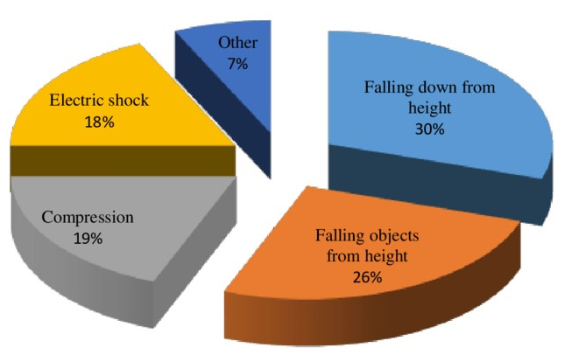
Occupational Health and Safety
Making working conditions healthy and safe is in the interest of workers, employers and governments, as well as the public at large. Although it seems simple and obvious, this idea has not yet gained meaningful universal recognition. Hundreds of millions of people throughout the world are employed today in conditions that breed ill health and/or are unsafe. Each year, work-related injuries and diseases kill an estimated 2 million people worldwide, which is greater than the global annual number of deaths from malaria (sıtma). Annually, an estimated 160 million new cases of work-related diseases occur worldwide, including respiratory and cardiovascular diseases, cancer, hearing loss, musculoskeletal and reproductive disorders, mental and neurological illnesses.
Percentages of occupational accidents that lead to fatality in Turkish Construction Industry, the largest industrial sector in Turkey

Slide 17
Occupational Health and Safety
Any organization is responsible to make every effort to operate in a safe environment and introduce safety management system for three main reasons that are identified in the field of occupational safety and health. These include moral, financial and legitimate reasons.
Moral: No employee shall be injured or become ill while performing work. Taking care of employees’ health and safety is the primary moral obligation of every employer, director and/or shareholder. In fact, any virtuous person must understand the fact that all employees have a right to get home from work in good health. Financial: Having high standards of occupational safety and health leads the company to save a big amount of money and reduce unexpected costs, while low standards of occupational safety are always associated with undesirable costs deriving from fine sanctions, compensations, law suits, injured employees, missed working days, delayed working process, malfunctioning equipment and machinery, in addition, damaged reputation, which might become the cause of significant financial loss.
Legitimate: Finally, in case the above-mentioned two reasons are not enough for the company to start considering improvement of occupational safety standards, then we must realize that it is required by almost all countries’ applicable legislation (mevzuat) that minimum standards of health and safety must be maintained at workplace by every organization. Fine sanctions are also specified in such legislation.

Slide 18
Occupational Health and Safety
According to WHO, occupational health and safety can be defined as a multidisciplinary activity aiming at:
Protection and promotion of the health of workers by eliminating occupational factors and conditions hazardous to health and safety at work,
Enhancement of physical, mental and social well-being of workers and support for the development and maintenance of their working capacity, as well as professional and social development at work and
Development and promotion of sustainable work environments and work organizations.
Hence The ILO/WHO (labour == iş gücü) defines occupational health and safety as “The promotion and maintenance of the highest degree of physical, mental social well- being of workers in all occupation”.
Occupational Health is a diverse science applied by occupational health professional engineers, environmental health practitioners, chemists, toxicologists, doctors, nurses, safety professionals and others who have an interest in the protection of the health of workers in the workplace

Slide 19
Occupational Health and Safety
The discipline covers the following key components:
The availability of occupational health and safety regulations at workplace;
The availability of active and functional occupational health and safety committee at workplace;
Monitoring and control of factory hazards to health;
Supervision and monitoring of hygiene and sanitary facilities for health and welfare of the workers;
Inspection of health safety of protective devices;
Pre-employment, periodical and special health examination;
Performance of adaptation of work to man;
Provision of First Aid;
Health education and safety training to the worker;
Advice to employers on the above mentioned items; and,
Reporting of occupational deaths, diseases, injuries, disabilities, hazards and their related preventive measures at working.

Slide 20
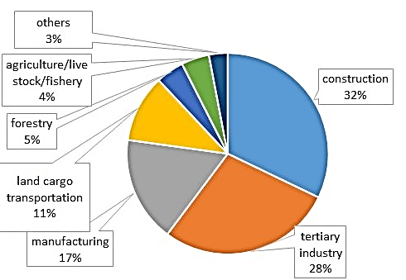
Occupational Health and Safety
According to a statement by occupational health institutes collaborating with the WHO, the most important challenges for occupational health for the future will be:
Occupational health problems linked to new information technologies and automation;
New chemical substances and physical energies;
Health hazards associated with new biotechnologies;
Transfer of hazardous technologies;
Aging working populations
Special problems of vulnerable and underserved groups (e.g. chronically ill and handicapped), including migrants and the unemployed; and,
Problems related to growing mobility of worker populations and occurrence of new occupational diseases of various origins.
According to WHO, Percentage of sectorial
fatalities in 2020

Slide 21
Occupational Health and Safety
Objectives of Occupational Health and Safety
To maintain and promote the physical, mental and social well-being of the workers.
To prevent occupational injuries and diseases.
To adapt the workplace and work environment to the needs of the workers i.e application of ergonomic principles.
It should be preventive (önleyici) rather than curative (iyileştirici).

Slide 22
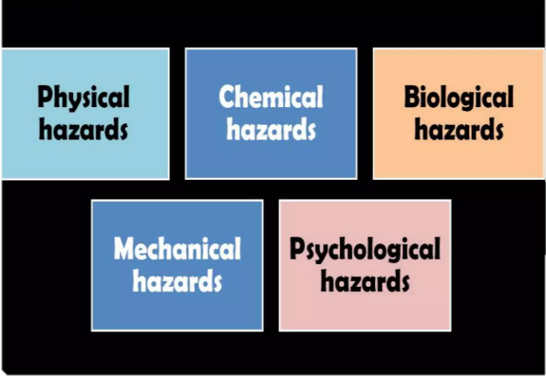
Occupational Health and Safety
Occupational Hazards

Slide 23
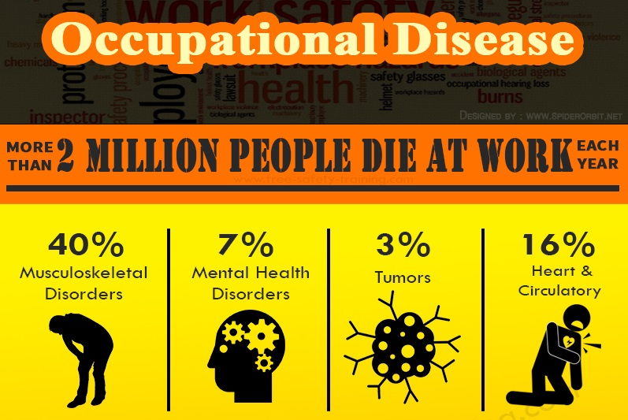
Occupational Health and Safety
Occupational Diseases:
Diseases due to physical agents.
Diseases due to chemical agents.
Diseases due to biological agents.
Occupational cancers.
Occupational dermatitis
Diseases of psychological origin.

Slide 24
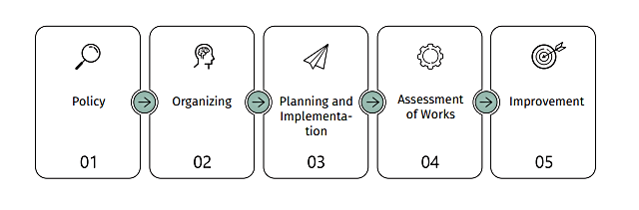
Occupational Health and Safety
Safety management system developed in accordance with ISO, ILO HSG2 and other approved standards is based on the following 5 steps:

Slide 25
Occupational Health and Safety
Policy
The first step of management system is called policy. During this stage organizations define main goals and principles/intentions related to occupational health and safety. The goals must be defined in writing – in the form of a small document, which is referred to as Occupational Safety Policy. Drafting a policy document is the best way to introduce the company’s views related to occupational safety and health. For instance, the company’s occupational safety document might define the following goals:
The organization is obliged to protect each employees’ health and safety through preventing accidents, work injuries and occupational diseases.
To reduce the number cases of human injury as well as material loss and damage to the environment to the minimum through continuous assessment and control of risks.
The company is obliged to ensure involvement of each employee as well as provide consultations and trainings in occupational health and safety.
The company is obliged to provide continuous monitoring and improvement of the steps in safety management system. Willingness of the organization to operate in accordance with local laws and regulations.
Willingness of the organization to operate in accordance with local laws and regulations.

Slide 26
Occupational Health and Safety
Organizing
During the organizing stage the company defines and develops structure, resources and measures needed to effectively meet the goals identified in the document. During this stage the company lays the foundation for effective management of safety processes. Without a strong foundation the processes will fail. For this reason it is vitally important to accurately and carefully manage processes at this stage.
During the organizing stage the company must introduce and implement the following processes:
Define duties and responsibilities of employees.
To determine the necessary competence (yeterlilik) for performing work and provide appropriate trainings/sessions.
To draft documents (action plan) of Occupational Safety and Health.
To define and introduce ways of communication.

Slide 27
Occupational Health and Safety
Planning and Implementation
At this stage the company puts all the principles into practice that were developed during previous stages, identifies hazards, assesses risks on a regular basis and introduces relevant control mechanisms, in addition, plans and performs works and supervises their proper completion. This stage of management system requires the biggest amount of work. In fact, all scheduled works are performed now. In addition, the company monitors, examines, detects and eliminates errors and faults on a regular basis; moreover, collects statistical data (KPI).
At the stage of planning and implementation the following steps must be taken:
Schedule and perform Works.
Identify hazards and assess risks.
Supervise ongoing Works.
Collect occupational safety data - Key Performance Indication (KPI)

Slide 28
Occupational Health and Safety
Assessment of Works
At this stage of management system, through monitoring, collecting and assessing statistical data the company determines to what extent the company goals and intentions coincide with the final results and completed works.
At this stage of management system the company studies all the statistical data of the past period (year, project) and through the engagement of top management discusses system faults in safety processes and improvement plan.
Two main activities are carried out at this level:
Monitoring, Assessment and Analysis of Key Performance Indicator (KPI).
Analysis of the causes of incidents that have been reported and studied.

Slide 29
Occupational Health and Safety
Improvement
No matter how successfully the company implements the first four stages of safety management system, there will always be some faults. If the company has difficulties detecting faults and does not pay much attention or moreover, sometimes completely ignores their existence, there might be 2 serious problems in the company:
There is a lack of relevant competence to detect faults.
Faults are detected but not reported to decision makers in the company.
Even the perfect management systems have some defects. Detection and improvement is the key to strengthening and developing reporting culture of occupational safety. One of the main components of management system is its cyclic character and possibility for continuous development.
At the stage of improvement management team along with occupational representatives or department discuss the faults detected during the stage of completed work assessment and analyze statistical data that must be definitely improved in the future. Discussions must be followed by relevant recommendations and fulfilment of these recommendations will ensure future improvement of safety management system.

Slide 30
Occupational Health and Safety
The common problems encountered in the development of occupational health services include:
Lack of awareness among workers, employers, health planners, policy makers, health professionals and public at large.
Lack of trained human resource.
Inadequate, inaccessible, and inequitably distributed health service institutions.
Lack of multidisciplinary staff, absence of field-testing equipment for conducting environmental and biological monitoring of the work place and the health of the workers.
Insufficient budget for carrying out regular inspections, conducting research activities.
The characteristics of the workers, the majorities are poor, illiterate or poorly educated.
Poor working environment.
No specific regulation/ legislation on occupational health and safety issues.
Unfavourable climatic condition and heavy load of endemic disease: such as bilharzia, onchocerciasis, Malaria, leishmaniasis, and trypanosomiasis.
Absence of training institution on occupational health and safety.
Little or no collaboration or cooperation among stakeholders
Poor information exchange /network in the area of OHS
Lack of multidisciplinary forum or panel
Absence of integration of occupational health and safety with general health service

Slide 31

Occupational Health and Safety
Elements of the Work Environment
The basic elements in an occupational setting such as a manufacturing plant, industry, or offices are four. These are:
The employees
The tool
The process
The work environment

Slide 32
Occupational Health and Safety
The employees
The employee means a person who is employed for wages under a contract of service on or in connection with the work of an industry and:
who is directly employed by the principal employer on any work of, or incidental or preliminary to or connected with the work of, the industry, whether such work is done by the employee at the place of work or elsewhere;
who is employed by or through an immediate employer at the place of work of the industry or under the supervision of the principal employer or his agent on work which is ordinarily part of the work of the industry or which is preliminary to the work carried on in or incidental to the purpose of the industry; or
whose services are temporarily lent or let on hire to the principal employer by the person with whom the person whose services are so lent or let on hire has entered into a contract of service;

Slide 33
Occupational Health and Safety
Vulnerable populations in any country are at even greater risks. These groups are:
Women workers The gender division of labour has an impact on women’s health and safety in the workplace, which goes well beyond reproductive hazards
Home-based workers Some countries regard them as ordinary employees, subject to normal health and safety legislation. In other countries, they are not included in legislation
Part-time workers
Contract workers
Drivers

Slide 34


Occupational Health and Safety
The Tool
Tools can range from very primitive tools like a hammer, chisel, and needle, to automated equipment.

Slide 35
Occupational Health and Safety
The process
In the process, materials used can be toxic. The process itself can affect the potential harmfulness of the materials. For example, the particle size or physical state (solid, liquid and gas) of potentially harmful substances can determine to a large extent what ill effects in workers may develop from those substances

Slide 36
Occupational Health and Safety
The work environment Occupational environment means the sum of external conditions and influences which prevail at the place of work and which have a bearing on the health of the working population. The industrial worker today is placed in a highly complicated environment and the work environment is getting more complicated as human is becoming more innovative or inventive.

Slide 37
Occupational Health and Safety
Reasons in Poor Performance
Reasons for these (poor and hazardous performances) are:
Workplace
Unsafe building
Old machines
Poor ventilation
Noise
Inaccessible to inspection
Workers
Limited education
Limited skill and training
Employers
Limited financial resources
Low attention and knowledge
In many developing nations, death rates due to occupational accident among workers are five to six times higher than those in industrialized countries; yet, the situation in developing countries is still largely undocumented due to poor recording system.

Slide 38
Occupational Health and Safety
Groups at Particular Risk
Some groups either seem to be particularly at risk or their specific problems are overlooked. For example:
The special position of women workers needs attention. The gender division of labour has an impact on women’s health and safety in the workplace, which goes well beyond reproductive hazards.
Health and safety is male dominated. 86% of Health and Safety Inspectors are male. Resources are traditionally invested far more on male industries, rather than areas of industry where women work. Safety standards are based on the model of a male worker. Tasks and equipment are designed for male body size and shape. This can lead to discrimination in a number of areas.
There are many home-based workers, in both developed and developing countries. Some countries regard them as ordinary employees, subject to normal health and safety legislation. In other countries, they are not included in legislation. But countries that ratify the Home Work Convention, 1996 (No. 177), must ensure protection in the field of occupational health and safety equal to that enjoyed by other workers.
Part-time workers are another group who may suffer from not being covered by health and safety provisions. This is why the Part-Time Work Convention, 1994 (No. 175), stipulates that measures shall be taken to ensure that part-time workers receive the same protection as that accorded to comparable fulltime workers in respect of occupational safety and health.

Slide 39
Occupational Health and Safety
Another group that should be considered are contract workers, whose accident rate is on average twice that of permanent workers. Many employers seem to believe that by subcontracting certain tasks, they subcontract their safety responsibilities. This is not the case.
Drivers are particularly at risk. International estimates suggest that between 15 and 20 per cent of fatalities caused by road accidents are suffered by people in the course of their work, but these deaths are treated as road traffic accidents rather than work-related fatalities.
Despite this worrying situation, international awareness of the magnitude of the problem remains surprisingly modest. The inadequate dissemination (bilginin yetersiz dağıtılması) of knowledge and information hampers action, especially in developing countries. It also limits the capacity to design and implement effective policies and programs. The fatality, accident and disease figures are alarming but investment decisions continue to be made in disregard of safety, health and environmental considerations. In the scramble for capital, globalization and increasingly stiff competition tend to deflect attention from the long-term economic benefits of a safe and healthy working environment. While the international press reports on major industrial accidents, the many work-related deaths that occur every day go virtually unrecorded. Workers continue to face serious risks. To reduce the human suffering and financial loss associated with these risks, there is a need for increased and sustained
action to protect occupational health and safety, and the environment.

Slide 40
Occupational Health and Safety
Core Principles of Occupational Health and Safety
Occupational health and safety is an extensive multidisciplinary field, invariably touching on issues related to, among other things, medicine and other scientific fields, law, technology, economics and concerns specific to various industries. Despite this variety of concerns and interests, certain basic principles can be identified, including the following:
- All workers have rights.
Workers, as well as employers and governments, must ensure that these rights are protected and foster decent conditions of labour. As the International Labour Conference stated in 1984:
work should take place in a safe and healthy working environment;
conditions of work should be consistent with workers’ well-being and human dignity;
work should offer real possibilities for personal achievement, self-fulfillment and service to society.
Occupational health and safety regulations must be established.
Such policies must be implemented at both the governmental and enterprise levels. They must be effectively communicated to all parties concerned.

Slide 41
Occupational Health and Safety
- There is need for consultation with the social partners (that is, employers and workers) and other stakeholders.
This should be done during formulation, implementation and review of such policies.
- Prevention and protection must be the aim of occupational health and safety programmes and policies. Efforts must be focused on primary prevention at the workplace level. Workplaces and working environments should be planned and designed to be safe and healthy.
- Information is vital for the development and implementation of effective programmes and policies.
The collection and dissemination (bilginin yayılması) of accurate information on hazards and hazardous materials, surveillance of workplaces, monitoring of compliance with policies and good practices, and other related activities are central to the establishment and enforcement of effective policies.
Health promotion is a central element of occupational health practice.
Efforts must be made to enhance workers’ physical, mental and social well-being.
20:28

Slide 42
Occupational Health and Safety
- Occupational health services covering all workers should be established.
Ideally, all workers in all categories of economic activity should have access to such services, which aim to protect and pro-mote workers’ health and improve working conditions.
- Compensation, rehabilitation and curative services must be made avail-able to workers who suffer occupational injuries, accidents and work-related diseases.
Action must be taken to minimize the consequences of occupational hazards.
- Education and training are vital components of safe, healthy working environments. Workers and employers must be made aware of the importance and the means of establishing safe working procedures. Trainers must be trained in areas of special relevance to different industries, which have specific occupational health and safety concerns.
- Workers, employers and competent authorities (yetkili makamlar) have certain responsibilities, duties and obligations.
For example, workers must follow established safety procedures; employers must provide safe workplaces and ensure access to first aid; and the competent authorities must devise (tasarlamalı), communicate and periodically review and update occupational health and safety policies.
- Policies must be enforced.
A system of inspection must be in place to secure compliance with O H&S and other labor legislation.

Slide 43
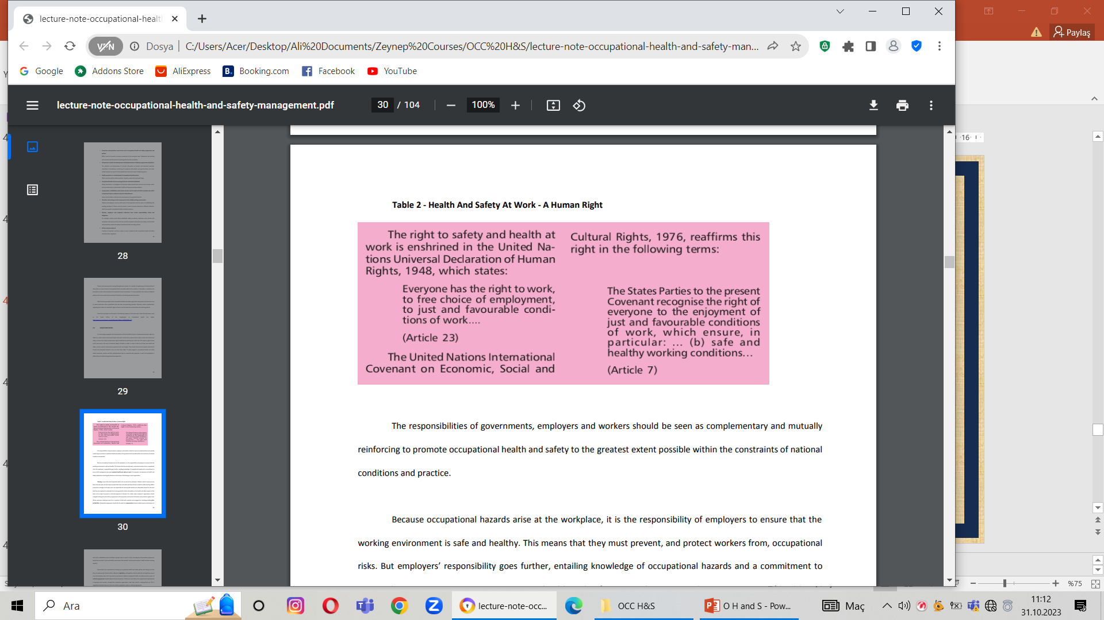
Occupational Health and Safety
Rights and Duties
It is increasingly recognized that the protection of life and health at work is a fundamental workers’ right; in other words, decent work implies safe work. Furthermore, workers have a duty to take care of their own safety, as well as the safety of anyone who might be affected by what they do or fail to do. This implies a right to know and to stop work in the case of imminent danger to health or safety. In order to take care of their own health and safety, workers need to understand occupational risks and dangers. They should therefore be properly informed of hazards and adequately trained to carry out their tasks safely. To make progress in occupational health and safety within enterprises, workers and their representatives have to cooperate with employers, as well as to participate in elaborating and implementing preventive programs.
Health and Safety at work is a human right

Slide 44
Occupational Health and Safety
The responsibilities of governments, employers and workers should be seen as complementary and mutually reinforcing to promote occupational health and safety to the greatest extent possible within the constraints of national conditions and practice. Because occupational hazards arise at the workplace, it is the responsibility of employers to ensure that the working environment is safe and healthy. This means that they must prevent, and protect workers from, occupational risks. But employers’ responsibility goes further, entailing knowledge of occupational hazards and a commitment to ensure that management processes promote health and safety at work. For example, an awareness of health and safety implications should guide decisions on the choice of technology or work organization. Training is one of the most important tasks to be carried out by employers. Workers need to know not only how to do their jobs, but also how to protect their lives and health and those of their co-workers while working. Within enterprises, managers and supervisors are responsible for ensuring that workers are adequately trained for the work that they are expected to undertake. Such training should include information on the health and safety aspects of the work, and on ways to prevent or minimize exposure to hazards. On a wider scale, employers’ organizations should instigate training and information programs on the prevention and control of hazards, and protection against risks. Where necessary, employers must be in a position to deal with accidents and emergencies, including providing first aid facilities. Adequate arrangements should also be made for compensation of work-related injuries and diseases, as well as for rehabilitation and to facilitate a prompt return to work. In short, the objective of preventive programs should be to provide a safe and healthy environment that protects and promotes workers’ health and their
working capacity.

Slide 45
Occupational Health and Safety
Governments are responsible for drawing up occupational health and safety policies and making sure that they are implemented. Policies will be reflected in legislation, and legislation must be enforced. But legislation cannot cover all workplace risks, and it may also be convenient to address occupational health and safety issues by means of collective agreements reached between the social partners. Policies are more likely to be supported and implemented if employers and workers, through their respective organizations, have had a hand in drawing them up. This is regardless of whether they are in the form of laws, regulations, codes or collective agreements.
The competent authority should issue and periodically review regulations or codes of practice; instigate research to identify hazards and to find ways of overcoming them; provide information and advice to employers and workers; and take specific measures to avoid catastrophes where potential risks are high.
The occupational health and safety policy should include provisions for the establishment, progressive extension and operation of occupational health services. The competent authority should supervise and advise on the implementation of a workers’ health surveillance system and its link with programs of prevention, protection and promotion of workers’ health at the enterprise and national levels. The information provided by surveillance will show whether occupational health and safety standards are being implemented, and where more needs to be
done to safeguard workers.

Slide 46
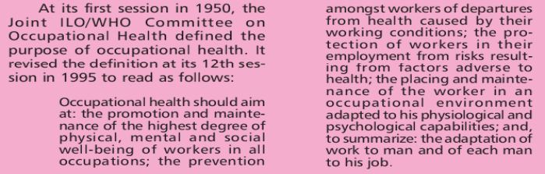
Occupational Health and Safety
A concise statement that encapsulates the main purposes of occupational health is the definition provided by the Joint ILO/WHO Committee.
As the definition indicates, the main focus in occupational health is on three different objectives:
(i)The maintenance and promotion of workers’ health and working capacity
(ii)The improvement of the working environment and work to be-come conducive to safety and health; and
Joint ILO/WHO Committee’s Definition of Occupational Health Purpose
(iii)The development of work organizations and working cultures in a direction that supports health and safety at work and thereby also promotes a positive social climate and smooth operation and may enhance productivity of the undertakings. The principle of working culture is intended in this context to mean a reflection of the essential value systems adopted by the undertaking concerned. Such a culture is reflected in practice in the managerial systems, personnel policy, principles for participation, training policies and quality management of the undertaking.

Slide 47
Occupational Health and Safety
Occupational Health and Safety Policy within the Enterprise
Since occupational accidents and work-related injuries to health occur at the individual workplace, preventive and control measures within the enterprise should be planned and initiated jointly by the employer, managers and workers concerned.
Measures for the prevention and control of occupational hazards in the workplace should be based upon a clear, implementable and well-defined policy at the level of the enterprise. The occupational health and safety policy represents the foundation from which occupational health and safety goals and objectives, performance measures, and other system components are developed. It should be concise, easily understood, approved by the highest level of management, and known by all employees in the organization.
The policy should be in written form and should cover the organizational arrangements to ensure occupational health and safety. In particular, it should:
Allocate the various responsibilities for occupational health and safety within the enterprise;
Bring policy information to the notice of every worker, supervisor and manager;
Determine how occupational health services are to be organized; and
Specify measures to be taken for the surveillance of the working environment and worker’s health.

Slide 48
Occupational Health and Safety
The policy may be expressed in terms of organizational mission and vision statements, as a document that reflects the enterprise’s occupational health and safety values. It should allocate the various responsibilities regarding occupational health and safety, including that of bringing policy information to the notice of every worker. The policy should also define the duties and responsibilities of the departmental head or the occupational safety and health team leader who will be the prime mover in the process of translating policy objectives into reality within the enterprise. Policy decisions are implemented as rapidly as possible; There is continuity of action; The measures taken by the various authorities are coordinated and harmonized; and resources are made available to enable the necessary measures to be taken. The policy document must be printed in a language or medium readily understood by the workers. Where illiteracy levels are high, clear non-verbal forms of communication must be used. The policy statement should be clearly formulated and designed to fit the particular organization for which it is intended. It should be circulated so that every employee has the opportunity to become familiar with it. The policy should also be prominently displayed throughout the workplace to act as a constant reminder to all. In particular, it should be posted in all management offices to remind managers of their obligations in this important aspect of company operations. In addition, appropriate measures should be taken by the competent authority to provide guidance to employers and workers so as to help them comply with their legal obligations. To ensure that the workers accept the health and safety policy objectives, the employer should establish the policy through a process of information exchange and discussion with them. Reviewing a policy statement also keeps it alive. A policy may need to be revised in the light of new experience, or because of new hazards or organizational changes. Revision may also be necessary if the nature of the work that is carried out changes, or if new plant or new hazards are introduced into the workplace. It may also be necessary
if new regulations, codes of practice or official guidelines relevant to the activities of the enterprise are issued.

Slide 49
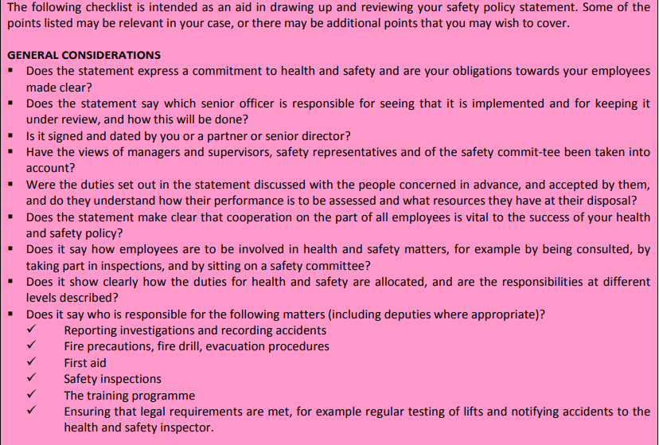
Occupational Health and Safety
Checklist for Employers Writing a Safety Policy Statement / 1

Slide 50
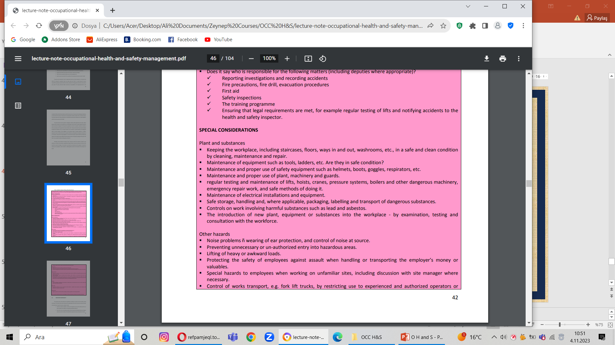
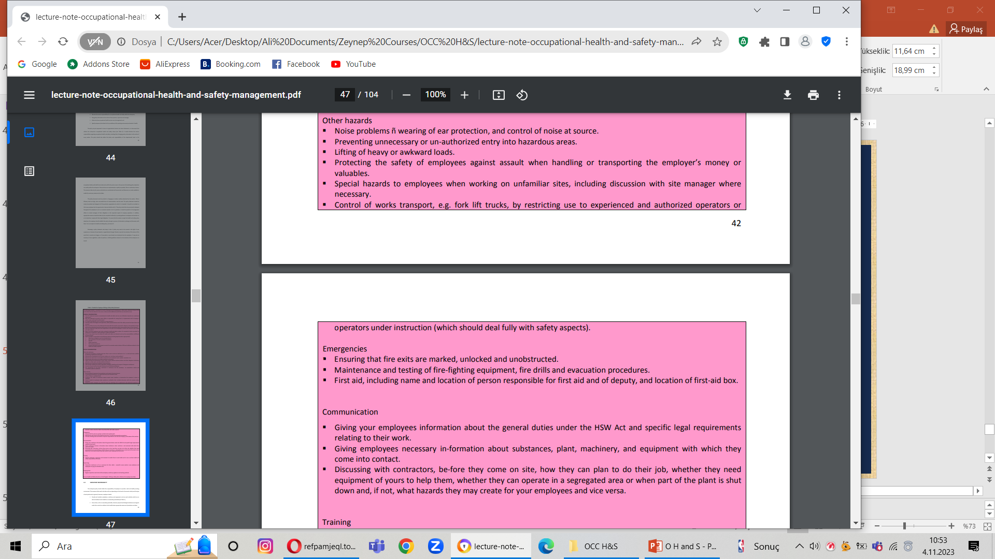
Occupational Health and Safety
Checklist for Employers Writing a Safety Policy Statement / 2

Slide 51
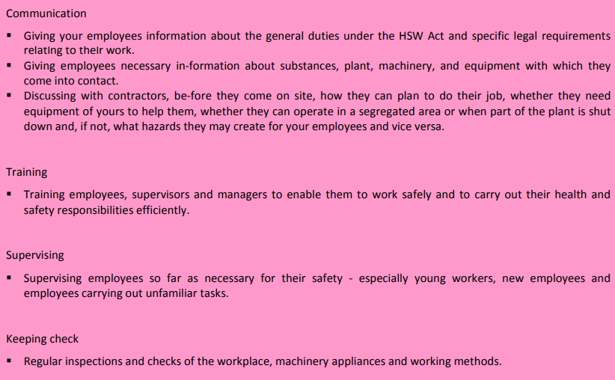
Occupational Health and Safety
Checklist for Employers Writing a Safety Policy Statement / 3

Slide 52
Occupational Health and Safety
Employer’s Responsibilities
The enterprise policy should reflect the responsibility of employers to provide a safe and healthy working environment. The measures that need to be taken will vary depending on the branch of economic activity and the type of work performed; in general, however, employers should:
Provide and maintain workplaces, machinery and equipment, and use work methods, which are as safe and without risk to health as is reasonably practicable
Ensure that, so far as reasonably practicable, chemical, physical and biological substances and agents under their control are without risk to health when appropriate measures of protection are taken;
Give the necessary instructions and training to managers and staff, taking account of the functions and capacities of different categories of workers;
Provide adequate super vision of work, of work practices and of the application and use of occupational health and safety measures;
Institute organizational arrangements regarding occupational safety and health adapted to the size of the undertaking and nature of its activities;
Provide adequate personal protective clothing and equipment without cost to the worker, when hazards cannot be otherwise prevented or controlled;
Ensure that work organization, particularly with respect to hours of work and rest breaks, does not adversely affect occupational safety and health;
Take all reasonable and practicable measures to eliminate excessive physical and mental fatigue;
Provide, where necessary, for measures to deal with emergencies and accidents, including adequate first-aid arrangements;
Undertake studies and research or otherwise keep abreast of the scientific and technical knowledge necessary to comply with the obligations listed above; and
Cooperate with other employers in improving occupational health and safety.

Slide 53
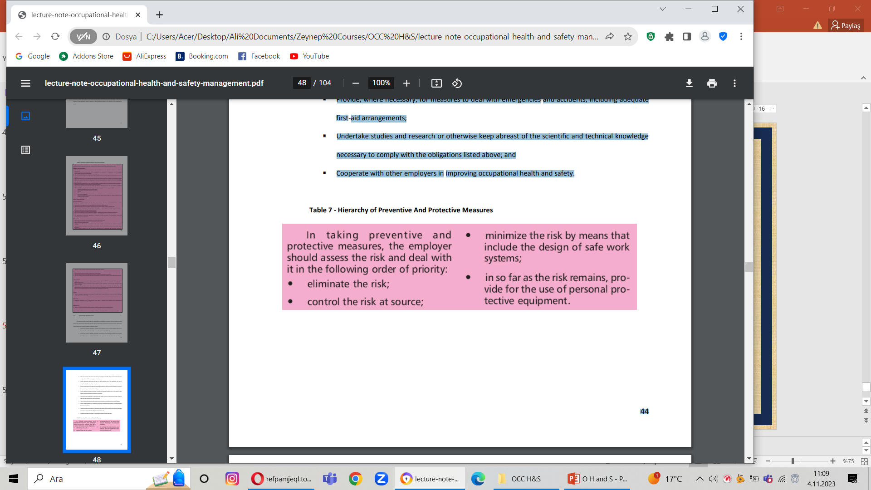

Occupational Health and Safety
Hierarchy of Preventive And Protective Measures
A short video assessing on the major safety responsibilities of the employer’s in UK which are accepted by the general public worldwide.

Slide 54
Occupational Health and Safety
Worker’s Duties and Rights
The cooperation of workers within the enterprise is vital for the prevention of occupational accidents and diseases. The enterprise policy should therefore encourage workers and their representatives to play their essential role in this regard and ensure that they are given adequate information on measures taken by the employer to secure occupational safety and health, appropriate training in occupational safety and health, as well as the opportunity to enquire into and be consulted by the employer on all aspects of occupational safety and health associated with their work. The enterprise policy should outline the individual duty of workers to cooperate in implementing the occupational health and safety policy within the enterprise. In particular, workers have a duty to:
Take reasonable care for their own safety and that of other per-sons who may be affected by their acts or omissions;
Comply with instructions given for their own safety and health, and those of others, and with safety and health procedures;
Use safety devices and protective equipment correctly (and not render them inoperative);
Report forthwith to their immediate super visor any situation which they have reason to believe could present a hazard and which they cannot themselves correct; and
Report any accident or injury to health which arises in the course of or in connection with work.

Slide 55
Occupational Health and Safety
Workers’ duties in hazard control have as their counterpart the recognition of certain basic rights, and these should also be reflected in the enterprise policy. In particular, workers have the right to remove themselves from danger, and to refuse to carry out or continue work which they have reasonable justification to believe presents an imminent and serious threat to their life or health. They should be protected from unforeseen consequences of their actions. In addition, workers should be able to:
Request and obtain, where there is cause for concern on health and safety grounds, inspections and investigations to be conducted by the employer and the competent authority;
Know and be informed of workplace hazards that may affect their health or safety;
Obtain information relevant to their health or safety, held by the employer or the competent authority; and
Collectively select health and safety representatives

Slide 56

Occupational Health and Safety
Access to better information is a prime condition for significant, positive contributions by workers and their representatives to occupational hazard control. The enterprise policy should make sure that workers are able to obtain any necessary assistance in this regard from their trade union organizations, which have a legitimate right to be involved in anything that concerns the protection of the life and health of their members.
A short video assessing on the major safety responsibilities of the employees as accepted by the general public.

Slide 57
Occupational Health and Safety
Health and Safety Committees
Cooperation between management and workers or their representatives at the workplace, in the field of occupational health and safety, is an essential element in maintaining a healthy working environment. It may also contribute to the establishment and maintenance of a good social climate and to the achievement of wider objectives. Depending on national practice, this cooperation could be facilitated by the appointment of workers’ safety delegates, or workers’ safety and health committees, or joint safety and health committees, composed equally of workers’ and employers’ representatives. Workers’ organizations play a very important role in reducing the toll of accidents and ill health. One study found that establishments with joint consultative committees, where all employee representatives were appointed by unions, had significantly fewer workplace injuries than those where the management alone determined health and safety arrangements. The appointment of joint health and safety committees and of workers’ safety delegates is now common practice, and can help to promote workers’ active involvement in health and safety work. Furthermore, safety delegates are known to be effective in the tasks of monitoring the health and safety aspects of shop-floor operations and in introducing corrective measures where necessary.

Slide 58
Occupational Health and Safety
Joint health and safety committees provide a valuable framework for discussion and for concerted action to improve safety and health. They should meet regularly and should periodically inspect the workplace. Workers’ safety delegates, workers’ safety and health committees, and joint safety and health committees should be:
Given adequate information on health and safety matters;
Enabled to examine factors affecting health and safety;
Encouraged to propose safety and health measures;
Consulted when major new safety and health measures are envisaged and before they are carried out;
Ready to seek the support of workers for health and safety measures;
Consulted in planning alterations of work processes, work con-tent or organization of work which may have safety or health implications for workers;
Given protection from dismissal and other measures prejudicial to them while exercising their functions in the field of occupational health and safety as workers’ representatives or as members of health and safety committees;
Able to contribute to the decision-making process within the enterprise regarding matters of health and safety;
Allowed access to all parts of the workplace;
Able to communicate with workers on health and safety matters during working hours at the workplace;
Free to contact labour inspectors;
Able to contribute to negotiations within the enterprise on occupational health and safety matters;
Granted reasonable time during paid working hours to exercise their health and safety functions and to receive
training related to these functions; and
Able to have recourse to specialists for advice on particular health and safety problems.

Slide 59
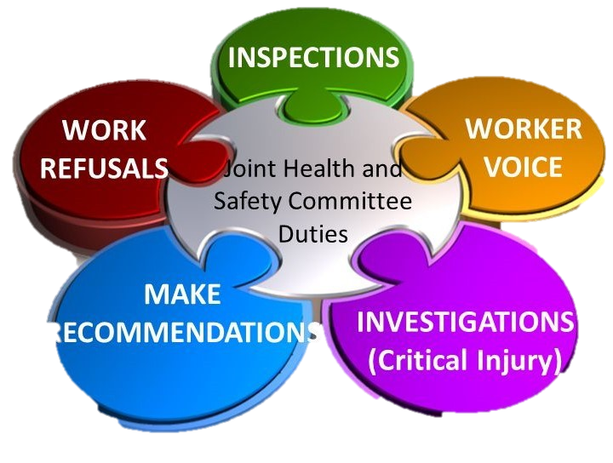
Occupational Health and Safety
Safety committees or joint health and safety committees have already been set up in larger enterprises in a number of countries. Smaller firms sometimes group together to set up regional health and safety committees for each branch of activity. The most promising results seem to have been achieved when management has concentrated on increasing workers’ awareness of their important role in health and safety and encouraged them to assume their responsibilities more fully.

Slide 60
Occupational Health and Safety
Management of Occupational Health and Safety
The protection of workers from occupational accidents and dis-eases is primarily a management responsibility, on a par with other managerial tasks such as setting production targets, ensuring the quality of products or providing customer services. Management sets the direction for the company. The strategic vision and mission statement establish a context for growth, profitability and production, as well as placing a value on workers’ safety and health throughout the enterprise. The system for managing safety and health should be integrated within the company’s business culture and processes. If management demonstrates in words and action, through policies, procedures and financial incentives, that it is committed to workers’ health and safety, then super visors and workers will respond by ensuring that work is performed safely throughout the enterprise. Occupational safety and health should not be treated as a separate process, but one that is integral to the way in which activities take place in the company. In order to achieve the objective of safe and healthy working conditions and environment, employers should institute organizational arrangements adapted to the size of the enterprise and the nature of its activities.

Slide 61
Occupational Health and Safety
Management Commitment and Resources
While top management has the ultimate responsibility for the health and safety program in an enterprise, authority should be delegated to all management levels for ensuring safe operation. Supervisors are obviously the key persons in such a program because they are in constant contact with the employees. As safety officers, they act in a staff capacity to help administer safety policy, to provide technical information, to help with training and to supply program material.
Total commitment on the part of management to making health and safety a priority is essential to a successful occupational health and safety program in the workplace. It is only when management plays a positive role that workers view such programs as a worth-while and sustainable exercise. The boardroom has the influence, power and resources to take initiatives and to set the pattern for a safe and healthy working environment.

Slide 62
Occupational Health and Safety
Management commitment to occupational health and safety may be demonstrated in various ways, such as:
Allocating sufficient resources (financial and human) for the proper functioning of the occupational health and safety program;
Establishing organizational structures to support managers and employees in their occupational health and safety duties; and
Designating a senior management representative to be responsible for overseeing the proper functioning of occupational health and safety management.
The process of organizing and running an occupational health and safety system requires substantial capital investment. To manage health and safety efficiently, the financial resources must be allocated within business units as part of overall running costs. The local management team must understand the value that corporate leaders place on providing a safe place of work for employees. There should be incentives for managers to ensure that resources are deployed for all aspects of health and safety. The challenge is to institutionalize health and safety within the planning process. Once the program is under way, concerted efforts must be made to guarantee its sustainability.

Slide 63
Occupational Health and Safety
Employees’ Participation
Cooperation between management and workers or their representatives within an enterprise is an essential element of the organizational measures that need to be taken in order to prevent occupational accidents and diseases at the workplace. Participation is a fundamental workers’ right, and it is also a duty. Employers have various obligations with regard to providing a safe and healthy workplace (see Chapter 4), and workers should, in the course of performing their work, cooperate in order to enable their employer to fulfill those obligations. Their representatives in the undertaking must also cooperate with the employer in the field of occupational health and safety.
Employee participation has been identified as the determinant of successful occupational health and safety management and a major contributing factor in the reduction of occupational diseases and injuries. The full participation of workers in any occupational health and safety programs designed for their benefit will not only ensure the efficacy of such measures, but also make it possible to sustain an acceptable level of health and safety at a reasonable cost. At the shop-floor level, workers and their representatives should be en-abled to participate in the definition of issues, goals and resulting actions related to occupational health and
safety.

Slide 64
Occupational Health and Safety
Training
The continuous integration of improvements into the work process is vital, but it is possible only if everyone involved is properly trained. Training is an essential element in maintaining a healthy and safe workplace and has been an integral component of occupational health and safety management for many years. Managers, supervisory staff and workers all need to be trained. Workers and their representatives in the undertaking should be given appropriate training in occupational health and safety. It is up to management to give the necessary instructions and training, taking account of the functions and capacities of different categories of workers. The primary role of training in occupational health and safety is to pro-mote action. It must therefore stimulate awareness, impart knowledge and help recipients to adapt to their own roles.
Training in occupational health and safety should not be treated in isolation; it should feature as an integral part of job training and be incorporated into daily work procedures on the shop floor. Management must ensure that all those who play a part in the production process are trained in the technical skills that they need to do their work. Training for the acquisition of technical skills should there-fore always include a component of occupational health and safety.

Slide 65
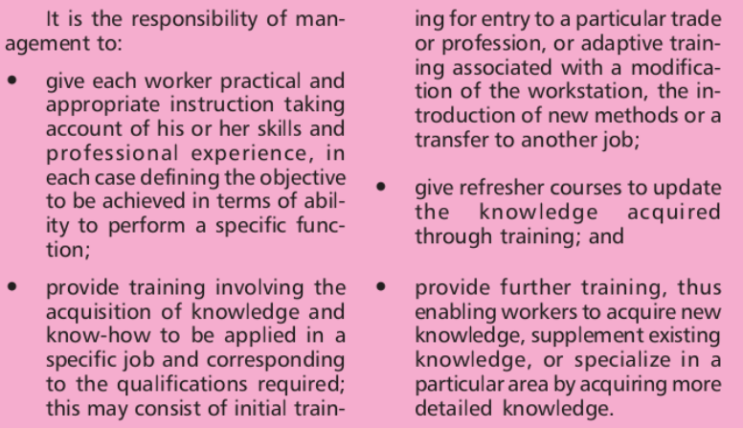
Occupational Health and Safety
Management Responsibilities in Occupational Health and Safety Training

Slide 66
Occupational Health and Safety
Organizational Aspects
The control of occupational hazards and diseases requires adequate organizational measures. As there is no perfect model for an organizational structure, a choice has to be made by weighing up the anticipated merits and disadvantages of various systems. Moderation should be the guiding principle, and a step-by-step approach is likely to be more successful than an overambitious scheme that does not allow for subsequent adjustment.
(i) Setting priorities
The first step is to establish priorities among objectives by assessing the main factors contributing to the hazards with the most severe consequences. High priority may also be allocated to actions that will produce rapid results, as early successes will enhance the credibility of efforts. Priorities may change from time to time, de-pending on the existing situation. It should be reiterated that cooperation between management and workers or their 53 representatives within the enterprise is essential in ensuring the successful implementation of an organizational structure for occupational health and safety.

Slide 67
Occupational Health and Safety
(ii) Planning and development activities
These need to be undertaken both in initially setting up the occupational health and safety management system and in its ongoing re-vision and modification. Systems and procedures should be thought through logically, first identifying where injury or ill health can occur, and then instituting measures that will make the occurrences less likely. Management should put in place organizational arrangements that are adapted to the size of the undertaking and the nature of its activities. Such arrangements should include the preparation of work procedures on the basis of job safety analysis. In this case, the person responsible should deter mine the safest, most effective way of performing a given task.
(iii) The place of occupational health and safety management
Occupational health and safety management should not be treated as a separate process, but be integrated into other workplace activities. Its various functions and procedures should be embedded in management system and business processes in the enterprise, as well as within comparable structures in the community. For example, occupational health services in a small enterprise could be integrated with the primary health care provided within the community. This would be of benefit to workers and their families.

Slide 68
Occupational Health and Safety
Performance Measures
The ability to measure occupational health and safety performance over time is essential in order to verify that there is a continuous improvement in eliminating occupational injuries and illness. Employers should regularly verify the implementation of applicable standards on occupational health and safety, for instance by environmental monitoring, and should undertake systematic safety audits from time to time. Furthermore, they should keep records relating to occupational health and safety and the working environment, as specified by the competent authority. Such information might include records of all notifiable occupational accidents and injuries to health which arise in the course of or in connection with work, lists of authorizations and exemptions under laws or regulations relating to the super vision of the health of workers in the enterprise, and data concerning exposure to specified substances and agents. A comprehensive evaluation system would include baseline evaluations, auditing, self-inspection and self correction, incident investigation, medical surveillance, and management review activities.

Slide 69
Occupational Health and Safety
Legislation, Enforcements and Collective Agreements
Appropriate legislation and regulations, together with adequate means of enforcement, are essential for the protection of workers’ health and safety. Legislation is the very foundation of social order and justice; without it, or where it is not enforced, the door is wide open to all forms of abuse. Each country should therefore take such measures as may be necessary to protect workers’ health and safety. This could be by enacting laws or regulations, or any other method consistent with national conditions and practice and in consultation with the representative organizations of employers and workers concerned. The law directly regulates certain components of working conditions and the work environment, including hours of work and occupational health and safety. There are also provisions relating to trade unions and collective bargaining machinery, which establish conditions for negotiations between employers and workers. One of the greatest problems regarding labor legislation in many countries is its application in practice. It is therefore important for governments to take the necessary steps to ensure that there is an effective system of labour inspection to make certain that statutory requirements are met. This is often difficult because of a shortage of trained personnel. Another problem relates to the difficulty of dealing with new hazards, bearing in mind the speed at which technology is changing. In some cases such problems can be solved by employers and workers, through collective bar gaining. These two complementary approaches are outlined below.

Slide 70
Occupational Health and Safety
Labor Inspection
The enforcement of legal provisions concerning occupational health and safety and the working environment should be secured by an adequate and appropriate system of inspection. The system should be guided by the provisions of the relevant ILO instruments, without prejudice to the obligations of the countries that have ratified them. As provided in Article 3(1) of the Labor Inspection Convention, 1947 (No. 81), the functions of the system of labor inspection should be:
To secure the enforcement of the legal provisions relating to conditions of work and the protection of workers while engaged in their work, such as provisions relating to hours, wages, safety, health and welfare, the employment of children and young persons, and other connected matters, in so far as such provisions are enforceable by labour inspectors;
To supply technical information and advice to employers and workers concerning the most effective means of complying with the legal provisions;
To bring to the notice of the competent authority defects or abuses not specifically covered by existing legal provisions.

Slide 71
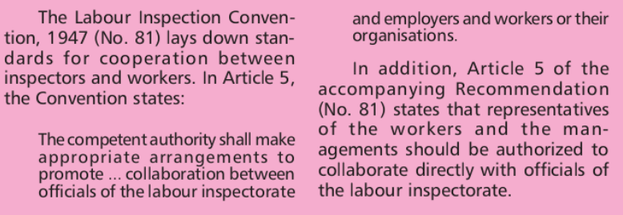
Occupational Health and Safety
For inspection to be taken seriously, labour legislation must be enforced systematically and forcefully. This may be a tall order in many countries because:
Legislation may not be sufficiently realistic;
Labour inspectors may have difficulty in imposing their authority;
Infrastructure facilities essential for inspection, such as adequate means of transport or communication, may not be available; and
Procedures may be lengthy and costly.
Cooperation Between Inspectors And Workers

Slide 72
Occupational Health and Safety
It is therefore imperative to broaden national labor inspection activities to involve employers and workers more actively, and to make greater efforts in the field of training. It should be stressed that any further duties which may be entrusted to labor inspectors should not be such as to interfere with the effective discharge of their primary duties or to prejudice in any way the authority and impartiality that are necessary to inspectors in their relations with employers and workers. Also, the need for the labor inspectorate staff to be well trained cannot be overemphasized. In view of the crucial role of labor inspection regarding national occupational health and safety programs, efforts must be made by the respective government authorities to strengthen the inspectorate. Depending on national approaches and circumstances, appropriate measures necessary to achieve the above objectives may include:
Improving the capacity to secure the enforcement of legal pro-visions;
Supplying technical information and advice;
Identifying new needs for action;
An increase in the number of inspectors;
Improved training for inspectors in support of their enforcement and advisory role;
The integration of separate inspection units or functions;
The use of multidisciplinary inspection teams;
Closer cooperation between labor inspectors and employers, workers and their organizations;
Improved statistical reporting systems of occupational accidents and diseases and inclusion in the annual
inspection report; and
Improved support facilities, institutions and other material arrangements.

Slide 73
Occupational Health and Safety
The labor inspectorate must have an adequate and well-trained staff, be provided with adequate resources, have an effective presence at the workplace, and take decisive action by being severe, persuasive or explanatory, depending on the case. It must be stated in conclusion that the conditions for an effective labor inspectorate, as discussed above, are very hard to attain in many countries of the world. The reasons are not difficult to understand, and include scarce resources, especially in countries undergoing various programs of economic reform, and the low priority given to occupational health and safety issues in the face of other competing demands. There is therefore very little justification for maintaining two parallel inspection systems, a practice that is still being observed in some countries. It is certainly more cost-effective to have an integrated system of inspection, whereby labor inspectors are also trained in health and safety issues. The mechanisms for achieving this process should be embodied in the national policy on occupational health and safety.

Slide 74
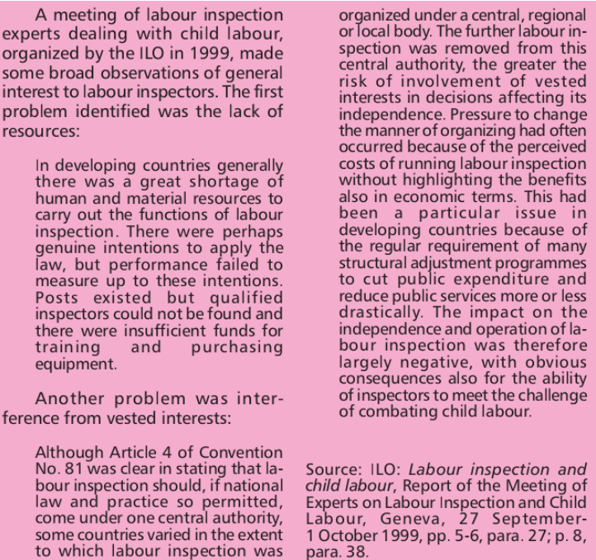
Occupational Health and Safety
Some Problems Of Labour Inspection

Slide 75
Occupational Health and Safety
Collective Bargaining
Since legislative processes are slow, collective agreements are particularly suitable for laying down requirements with respect to working conditions and the work environment in an enterprise. Collective bargaining is one of the most important and effective means of bringing about improvements in this field and should therefore be encouraged and promoted. It reflects the experience and interests of the employers and workers concerned, as well as the economic, technical and social realities of particular trades, branches of activity or enterprises. As Article 4 of the Right to
Organize and Collective Bargaining Convention, 1949 (No. 98) provides:
Measures appropriate to national conditions shall be taken, where necessary, to encourage and promote the full development and utilization of machinery for voluntary negotiation between employers and employers’ organizations, with a view to the regulation of terms and conditions of employment by means of collective agreements.
Collective agreements are more flexible than legislation and are better adapted to local problems concerning working conditions and the environment, or the technical and economic problems of a given sector. They may also stipulate flexible procedures to resolve conflicts arising out of their application, as well as setting agreed time limits for their revision. With regard to occupational health and safety, collective agreements have often been used to bring about genuine progress and a tangible improvement in workers’ conditions. This process is becoming increasingly common in small and
medium-sized enterprises, especially when the improvement in occupational health and safety is linked not just
to health issues, but also to increased productivity, higher-quality products and better morale among workers.

Slide 76

Occupational Health and Safety
Another possible forum for the discussion of working conditions and the environment is that of works committees or other similar bodies. Depending on the country and their terms of reference, they may have different names and deal with different problems, either general (works committees, works councils) or specific (occupational health and safety committees). They may either be bilateral (composed of a variable number of workers’ and management representatives) or consist of delegates elected by the workers or nominated by trade unions.

Slide 77
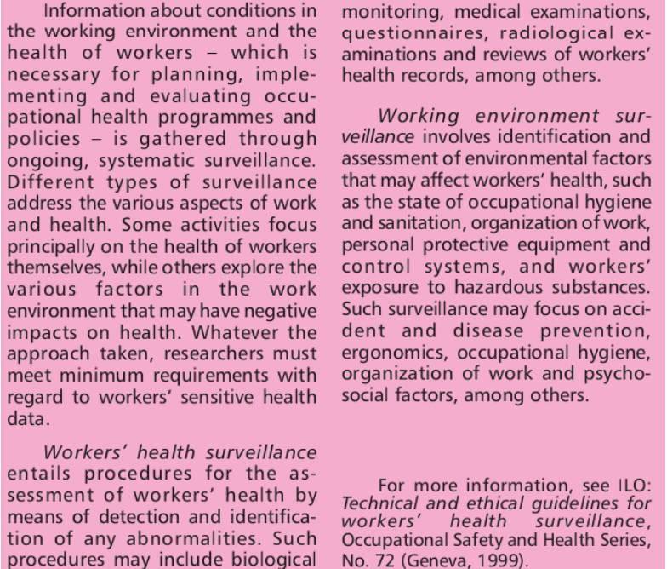
Occupational Health and Safety
Occupational Health Surveillance
Since the consequences of occupational hazards may not become apparent for many years, it is important to identify potential dangers early before they result in incurable diseases. The methods for identifying occupational hazards and the health problems associated with them can be broadly listed as environmental assessment, biological monitoring, medical surveillance and epidemiological approaches. Similar methods should be used to identify potential risks of accident. Some of the terminology associated with surveillance is explained in the table at the right hand side.
Surveillance, Work and Health

Slide 78
Occupational Health and Safety
Surveillance of the working environment
(i) General Framework
To ensure a healthy working environment there must be monitoring at the workplace. This involves systematic surveillance of the factors in the working environment and working practices which may affect workers’ health, including sanitary installations, canteens and housing where these facilities are provided by the employer, as well as ensuring the quality of the working environment through compliance with safety and health standards. Everyone associated with the workplace ñ from the worker right through to the employer ñ should be actively involved in the surveillance of the working environment. Basic surveillance is carried out by simple observation and every worker, from shop floor to administration, should be trained to be able to identify those factors (potential or real) which may affect workers’ health. Such training is necessary to enable the worker to report immediately to his or her direct super visor any situation which can reasonably be thought to present an imminent and serious danger to life or health. In such a situation, the employer cannot require the worker to return to work until any necessary remedial action is taken.
Simple observation (a walk-through survey) of work processes and the working environment is the first step in any surveillance. Such observation may be sufficient in some cases to detect a lack of adequate control measures and of exposure of workers to risk. The evaluation based on this type of observation may justify the recommendation of control measures without the need for any more sophisticated determination of the level of exposure. Visits to the workplace and walk-through observation are also necessary to provide an assurance that no deterioration has occurred at workplaces initially evaluated as satisfactory. Information from surveillance of the working environment should be combined with other data, such as epidemiological research or exposure limits, to assess occupational health risks. For a definition of the main concepts involved in risk assessment, see table on the next page.

Slide 79
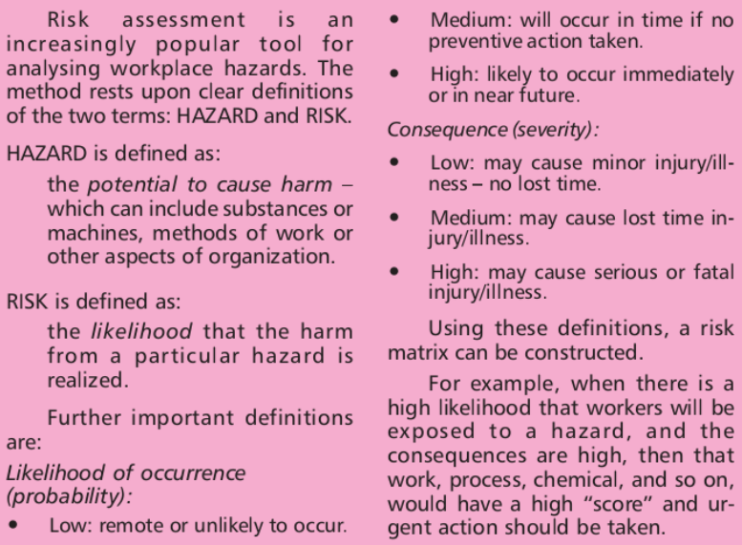
Occupational Health and Safety
An approach which is gaining widespread support is the precautionary principle. Simply stated, it is the need to foresee and forestall damaging human activities before science delivers irrefutable proof that there is a problem. We have seen many examples where concerns have been raised about a substance or process, to be told that there is no proof that it is harmful. By the time proof is established, hundreds, if not thousands, of people may have died, or suffered irreversible damage to their health.
Risk Assessment

Slide 80
Occupational Health and Safety
When an activity raises threats of harm to human health or the environment, precautionary measures should be taken even if some cause and effect relationships are not fully established scientifically. This is articulated in four clauses:
People have a duty to take anticipatory action to prevent harm;
The burden of proof of harmlessness of a new technology, process, activity or chemical lies with the activity’s proponents, not with the general public;
Before using a new technology, process or chemical, or starting a new activity, people have an obligation to examine a full range of alternatives, including the alternative of doing nothing; and
Decisions applying the precautionary principle must be open, informed and democratic, and must include affected parties.
The precautionary principle has now been incorporated into some international treaties and some national laws (e.g. Sweden’s chemical laws and the laws of some American states.)

Slide 81
Occupational Health and Safety

Slide 82
Occupational Health and Safety

Slide 83
Occupational Health and Safety

Slide 84
Occupational Health and Safety

Slide 85
Occupational Health and Safety

Slide 86
Occupational Health and Safety

Slide 87
Occupational Health and Safety

Slide 88
Occupational Health and Safety

Slide 89
Occupational Health and Safety

Slide 90
Occupational Health and Safety

Slide 91
Occupational Health and Safety

Slide 92
Occupational Health and Safety

Slide 93
Occupational Health and Safety

Slide 94
Occupational Health and Safety

Slide 95
Occupational Health and Safety

Slide 96
Occupational Health and Safety

Slide 97
Occupational Health and Safety

Slide 98
Occupational Health and Safety

Slide 99
Occupational Health and Safety

Slide 100
Occupational Health and Safety

Slide 101
Occupational Health and Safety

